Slide 1
Exploring Cryptography Protocols
with Limited Emphasis on Mathematics ☺
Presented By
@7eRoM

Slide 2
Attention
These slides have been crafted using the foundation of my MSc course in Cryptography Protocols at the University of ISfahan.
I've made adjustments to the content to align with the specific objectives of this presentation.
Also, My intention has been to minimize the use of mathematical concepts, which may result in some concepts being simplified or less precise.
Presented By
@7eRoM

Slide 3
Agenda
Identification and Entity Authentications Protocols
Zero Knowledge Protocols
Key Establishment Protocols
Threshold Cryptography and Secret Sharing Protocols
Special Purpose Protocols (like simultaneous contract signing, mental poker, fair exchange)
Identity Based Cryptography
Types of Digital Signatures
Secure Multiparty Computations

Slide 4
Special Purpose Protocols
Content
Commitment
Yes/No Election
Fair Coin Flipping by the Phone
Oblivious Transfer
Simultaneous Contract Signing
Certified Email
Fair Exchange
Mental Poker
Dining Cryptographers

Slide 5
Special Purpose Protocols
Commitment
An electronic way to temporarily hide a value that cannot be changed
Stage 1 (Commit)
Sender locks a message in a box and sends the locked box to another party called the Receiver
Stage 2 (Reveal)
Sender proves to the Receiver that the message in the box is a certain message

Slide 6
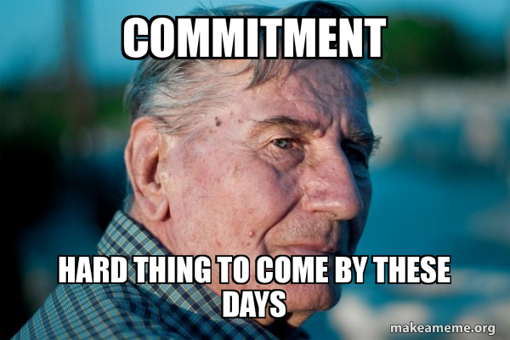
Special Purpose Protocols
Commitment

Slide 7
Special Purpose Protocols
Commitment
Hiding
at the end of Stage 1, no adversarial receiver learns any information about the committed value
Binding
at the end of Stage 1, no adversarial sender can successfully reveal two different values in Stage 2

Slide 8


Special Purpose Protocols
Bit Commitment - Using Symmetric Cryptography
Random bit string R
commits to b
E_{K}(R,b)
K
Bob decrypts the message to reveal the bit.
He checks his random string to verify the bit’s validity.

Slide 9
Special Purpose Protocols
Formalizing Security properties of commitment schemes
Two kinds of adversaries
those with infinite computation power and those with limited computation power
Unconditional hiding
the commitment phase does not leak any information about the committed message
Computational hiding
an adversary with limited computation power cannot learn anything about the committed message

Slide 10
Special Purpose Protocols
Formalizing Security properties of commitment schemes
Unconditional binding
after the commitment phase, an infinite powerful adversary sender cannot reveal two different values
Computational binding
after the commitment phase, an adversary with limited computation power cannot reveal two different values
No commitment scheme can be both unconditional hiding and unconditional binding

Slide 11
Special Purpose Protocols
Bit Commitment - Using One-Way Functions
Random string R1
Random string R2
h = H(R1|R2|b)
commits to b
R2
Calculates
h0 = H(R1|R2|0)
h1 = H(R1|R2|1)
Check h against h0 and h1

Slide 12
Special Purpose Protocols
Commitment – Pederson Scheme
Large prime p
2 ≤ g ≤ p-1
Large prime p
2 ≤ g ≤ p-1
Another element h
Random r
g^{x}h^{r} mod p
x , r
commits to x
Unconditionally Hiding
given x,r, and any x’, there exists r’ such that g^{x}h^{r}=g^{x’}h^{r’}
Computationally Binding
the sender to open another value x’≠x is hard.

Slide 13

Special Purpose Protocols
Commitment – Pederson Scheme
Large prime p
2 ≤ g ≤ p-1
Large prime p
2 ≤ g ≤ p-1
Another element h
Random y,s
1 ≤ y,s ≤ q
d = g^{y}h^{s} mod p
1 ≤ random challenge e ≤ q
Public Commitment
C=g^{x}h^{r} mod p
u=y+ex mod q
v=s+er mod q
Verification
g^{u}h^{v} == dc^{e} (mod p)
Private Knowledge
x,r
Remember?
Similar to Schnorr protocol

Slide 14
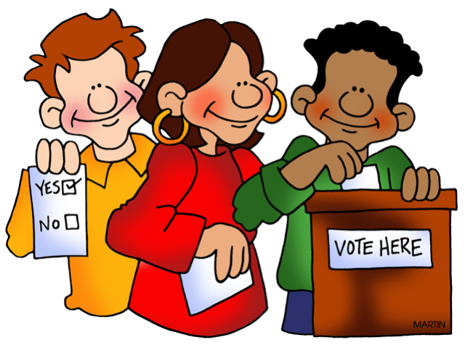


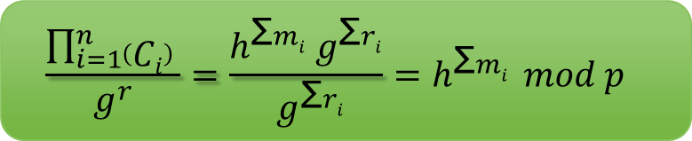
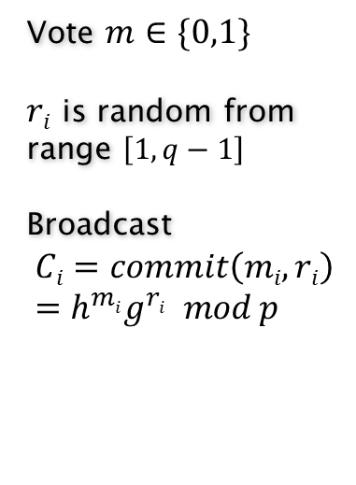
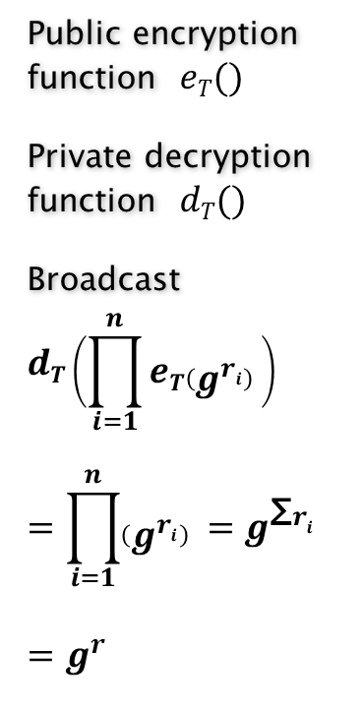
Special Purpose Protocols
Yes/No Election - Pederson Scheme
Vote $m∈\{0,1\}$
$ri$ is random from range $\left[1,q−1\right]$
Broadcast
$$Ci=commit\left(mi,ri\right)=h^{mi}g^{ri} mod p$$
Public encryption function $eT()$
Private decryption function $dT()$
Broadcast
$$dT\left(\prod_{i=1}^{n}{eT\left(g^{ri}\right) }\right)$$
$$=\prod_{i=1}^{n}{\left(g^{ri}\right) }=g^{\text{Σ}ri}$$
$$=g^{r}$$
$$eT(g^{ri})$$
Each user can calculate the result of election
$$\frac{\prod_{i=1}^{n}{\left(Ci\right) }}{g^{r}}=\frac{h^{\text{Σ}mi}{ g}^{\text{Σ}ri}}{{ g}^{\text{Σ}ri}}=h^{\text{Σ}mi } mod p$$

Slide 15

Special Purpose Protocols
Coin Flipping

Slide 16

Special Purpose Protocols
Coin Flipping – Using One-Way Function
y = H(x)
Random number x
Guesses x is even/odd
Head/Tail , x
Verification
y == H(x)
If Bob’s guess is correct, the result of the coin flip is heads.
If Bob’s guess is incorrect, the result of the coin flip is tails.

Slide 17
Special Purpose Protocols
Coin Flipping – Using Public-Key Cryptography
Commutative
D_{K1}(E_{k2}(E_{k1}(m))) = E_{k2}(m)
(pu_{A} , pr_{A})
(m₁ , m₂) two messages, one indicating heads and the other indicating tails.
E_{A}(M₁) , E_{A}(M₂)
(pu_{B} , pr_{B})
E_{B}(E_{A}(M_{X}))
D_{A}(E_{B}(E_{A}(M_{X}))) = E_{B}(M_{X})
D_{B}(E_{B}(M_{X})) = M_{X}
(pu_{A} , pr_{A})
(pu_{B} , pr_{B})

Slide 18

Special Purpose Protocols
Oblivious Transfer

Slide 19
Special Purpose Protocols
Oblivious Transfer
Joe Kilian’s story:
Suppose your netmail is being censored by
Captain Yossarian. Whenever you send a
message, he censors each bit of the
message with probability ½, replacing each
censored bit by some reversed character.

Slide 20
Special Purpose Protocols
Oblivious Transfer
Before:
Alice knows secret b
Bob knows nothing
After:
Either:
½ probability: Bob knows b
½ probability: Bob knows nothing
Alice doesn’t know if Bob knows b

Slide 21
Special Purpose Protocols
Oblivious Transfer
1 out of 2 OT
Alice has two secrets s₀ and s₁
At the end of the protocol
Bob gets exactly one of s₀ and s₁
Alice does not know which one Bob gets
1 out of n OT
Alice has n messages
Bob gets exactly one message, Alice does not know which one Bob gets

Slide 22
Special Purpose Protocols
Oblivious Transfer – Coin Toss with Capt. Yossarian
Picks
b=b₁⊕b₂⊕... ⊕b_{n}
Yossarian
Channel
b₁,b₂,...,b_{n}
Bob gets for example
b₁,X,X,b₄,...,b_{n-1},X
Guesses b is even/odd
Win/Lose
Bob wins if his guess is correct
What if Alice is a liar and tells Bob “You Lose”

Slide 23
Special Purpose Protocols
Oblivious Transfer – Coin Toss with Capt. Yossarian
Picks
b=b₁⊕b₂⊕... ⊕b_{n}
Yossarian
Channel
b₁,b₂,...,b_{n}
Bob gets for example
B₁,X,X,b₄,...,b_{n-1},X
Guesses b is even/odd
b₁,b₂,...,b_{n}
Bob can verify through calculating
b=b₁⊕b₂⊕... ⊕b_{n}
Bob wins if his guess is correct

Slide 24
Special Purpose Protocols
Oblivious Transfer – Coin Toss with Capt. Yossarian
Can we approximate oblivious transfer
without Capt. Yossarian channel?
Generates 2 publc-private pair keys
(pu₁ , pr₁)
(pu₂ , pr₂)
pu₁ , pu₂
Generates symmetric key K
E_{pux}(K)
Picks either
pu₁ or pu₂
E_{K1}(b₁) , E_{K2}(b₂)
K₁ = E_{pr1}(E_{pux}(K)) = K or meaningless bits
K₂ = E_{pr2}(E_{pux}(K)) = K or meaningless bits
Suppose Bob used pu₁
D_{K}(E_{K1}(b₁)) = b₁
D_{K}(E_{K1}(b₂)) = meaningless bits

Slide 25
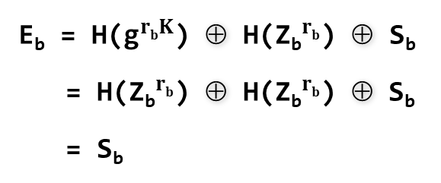
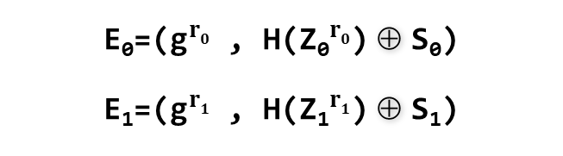
Special Purpose Protocols
Oblivious Transfer – Bellare-Micali 1-out-2-OT protocol
Secrets S₀ , S₁
group G of order q
generator g
c is random from range [1,q-1]
r₀,r₁ is random from range [1,q-1]
group G of order q
generator g
k is random from range [1,q-1]
c
Z₀ , Z₁
b is randomly 0 or 1
Z_{b} = g^{k}
Z_{1-b} = c * g^{-k}
E₀=(${\text{g}}^{r0}$ , H(${\text{Z}\text{0}}^{r0}$) ⊕ S₀)
E₁=(${\text{g}}^{r1}$ , H(${\text{Z}\text{1}}^{r1}$) ⊕ S₁)
Decrypts E_{b} = (v₁,v₂) by computing
H(v₁^{k})⊕v₂
E_{b} = H(${\text{g}}^{rbK}$) ⊕ H(${\text{Z}\text{b}}^{rb}$) ⊕ S_{b}
= H(${\text{Z}\text{b}}^{rb}$) ⊕ H(${\text{Z}\text{b}}^{rb}$) ⊕ S_{b}
= S_{b}

Slide 26
Special Purpose Protocols
Simultaneous Contract Signing
Alice and Bob wish to sign a contract under the condition that
neither of them will sign it until they ensure that the other party has also signed.

Slide 27
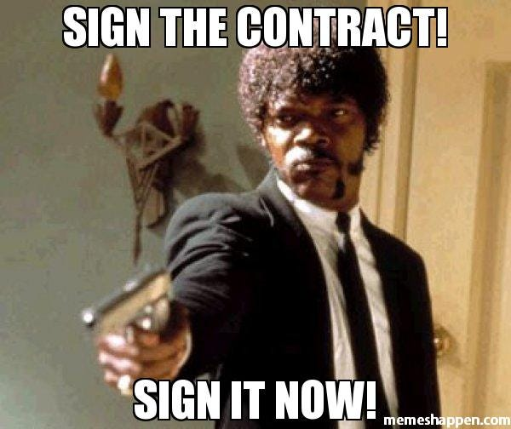
Special Purpose Protocols
Simultaneous Contract Signing

Slide 28
Special Purpose Protocols
Simultaneous Contract Signing – With Arbitrator
Arbitrator
A
B
Signs a copy of the contract
Signs a copy of the contract
Bob signed the contract
Alice signed the contract
A
Signs two copies of the contract
A

Slide 29
Special Purpose Protocols
Simultaneous Contract Signing – With Arbitrator
Arbitrator
A
B
If Alice or Bob refuses to sign, the other can request it from the arbitrator.
Signs a copy of the contract
Signs a copy of the contract
Bob signed the contract
Alice signed the contract
I received a copy of contract signed by both parties
I received a copy of contract signed by both parties
A B
A B
Signs two copies of the contract
Signs two copies of the contract and sends one of them

Slide 30
Special Purpose Protocols
Simultaneous Contract Signing – Face to Face & Without Arbitrator
Gradually Release
A
L
I
B
O
B
How many letters are required to signify a commitment to the contract?
There is no specific point for commitment.

Slide 31
Special Purpose Protocols
Simultaneous Contract Signing – Gradually Release
Taking small steps alternately to reach the final signature
Both parties send messages to each other one by one, alternatively, with each message stating 'I am committed to the contract with a probability of P.‘
The judge will grant the signer's commitment with a probability of p.

Slide 32
Special Purpose Protocols
Simultaneous Contract Signing – Gradually Release
Alice and Bob agree on the date by which the contract signature should be concluded
Both parties send messages to each other one by one, alternatively, with each message stating 'I am committed to the contract with a probability of P.‘
Alice decides that the difference between the probability of her commitment and Bob's commitment should not exceed 'a'.
Bob decides that the difference between the probability of her commitment and Bob's commitment should not exceed ‘b'.
Steps:
Alice sends a signed message with a confidence probability of 'p = a' to Bob.
Bob sends a signed message with a confidence probability of 'p = a+b' to Bob.
Each time, Alice increases the probability by 'a' and sends the message to Bob.
Each time, Bob increases the probability by ‘b' and sends the message to Alice.

Slide 33
Special Purpose Protocols
Simultaneous Contract Signing – Gradually Release
This process continues until both receive messages with a confidence probability of 'p = 1' or until the agreed-upon date passes.
If both receive messages with a confidence probability of '1', the process is complete; otherwise, ...
Each party can present the contract and the opponent's last signed message, which includes the confidence probability 'p' to the judge.
The judge randomly selects 'r' between 0 and 1. If 'r' is less than 'p' both parties are bound by the contract; otherwise, the judge does not accept either party's commitment.

Slide 34
Special Purpose Protocols
Simultaneous Contract Signing – based on DES
(K_{L1} , K_{R1})
(K_{L2} , K_{R2})
...
(K_{Ln} , K_{Rn})
(M_{L1} , M_{R1})
(M_{L2} , M_{R2})
...
(M_{Ln} , M_{Rn})
(C_{L1} , C_{R1})
(C_{L2} , C_{R2})
...
(C_{Ln} , C_{Rn})
(K_{L1} , K_{R1})
(K_{L2} , K_{R2})
...
(K_{Ln} , K_{Rn})
(M_{L1} , M_{R1})
(M_{L2} , M_{R2})
...
(M_{Ln} , M_{Rn})
K_{(L|R)1} K_{(L|R)2}
...
K_{(L|R)n}
E_{KLi}(M_{Li})=C_{Li}
E_{KRi}(M_{Ri})=C_{Ri}
E_{KLi}(M_{Li})=C_{Li}
E_{KRi}(M_{Ri})=C_{Ri}
Oblivious
Transfer
(C_{L1} , C_{R1})
(C_{L2} , C_{R2})
...
(C_{Ln} , C_{Rn})
(C_{L1} , C_{R1})
(C_{L2} , C_{R2})
...
(C_{Ln} , C_{Rn})
1st bit of 2n keys
Decrypts each half part of the Bob’s messages to verify
Decrypts each half part of the Alice’s messages to verify
2nd bit of 2n keys
.
.
.
Now, decrypts the other half and obtains the signed contract
Now, decrypts the other half and obtains the signed contract
n^{th} bit of 2n keys
The probability of Alice sending incorrect bits while Bob does not understand is $\frac{1}{\text{2}\text{n}}$

Slide 35
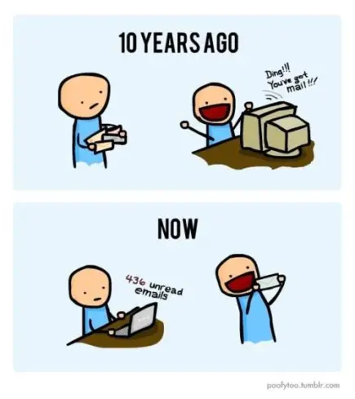
Special Purpose Protocols
Certified Email
Alice wants to send a letter to Bob in a way that
he cannot read the letter until he signs an acknowledgment receipt.

Slide 36
Special Purpose Protocols
R_{i} = R_{Li}+R_{Ri} = acknowledgment receipt
M = Alice’s Mail
J = Junk Message
K = Key
K_{Li} = Random bits
K_{Ri} = K⊕K_{Li}
Certified Email
E_{K}(M)
(R_{L1} , R_{R1})
(R_{L2} , R_{R2})
...
(R_{Ln} , R_{Rn})
(K_{L1} , K_{R1})
(K_{L2} , K_{R2})
...
(K_{Ln} , K_{Rn})
(C_{L1} , C_{R1})
(C_{L2} , C_{R2})
...
(C_{Ln} , C_{Rn})
(K_{L1} , K_{R1})
(K_{L2} , K_{R2})
...
(K_{Ln} , K_{Rn})
(J_{L1} , J_{R1})
(J_{L2} , J_{R2})
...
(J_{Ln} , J_{Rn})
(C_{L1} , C_{R1})
(C_{L2} , C_{R2})
...
(C_{Ln} , C_{Rn})
E_{KLi}(R_{Li})=C_{Li}
E_{KRi}(R_{Ri})=C_{Ri}
E_{KLi}(J_{Li})=C_{Li}
E_{KRi}(J_{Ri})=C_{Ri}
(C_{L1} , C_{R1})
(C_{L2} , C_{R2})
...
(C_{Ln} , C_{Rn})
K_{(L|R)1} K_{(L|R)2}
...
K_{(L|R)n}
(C_{L1} , C_{R1})
(C_{L2} , C_{R2})
...
(C_{Ln} , C_{Rn})
Oblivious
Transfer
1st bit of 2n keys
Now, decrypts the other half and obtains the signed contract
Now, decrypts the other half and obtains the signed contract
Bob regenerates K by doing XOR and then obtains Alice’s secret
2nd bit of 2n keys
Alice obtains Bob’s secret
.
.
.
Now, decrypts the other half and obtains the signed contract
Now, decrypts the other half and obtains the signed contract
n^{th} bit of 2n keys

Slide 37

Special Purpose Protocols
Fair Exchange of Secrets
Alice knows secret A and Bob knows secret B.
Alice shares secret A with Bob and receives secret B from him.
Also, Bob shares secret B with Alice and receives secret A from her.
How about the quality of the Secret!

Slide 38
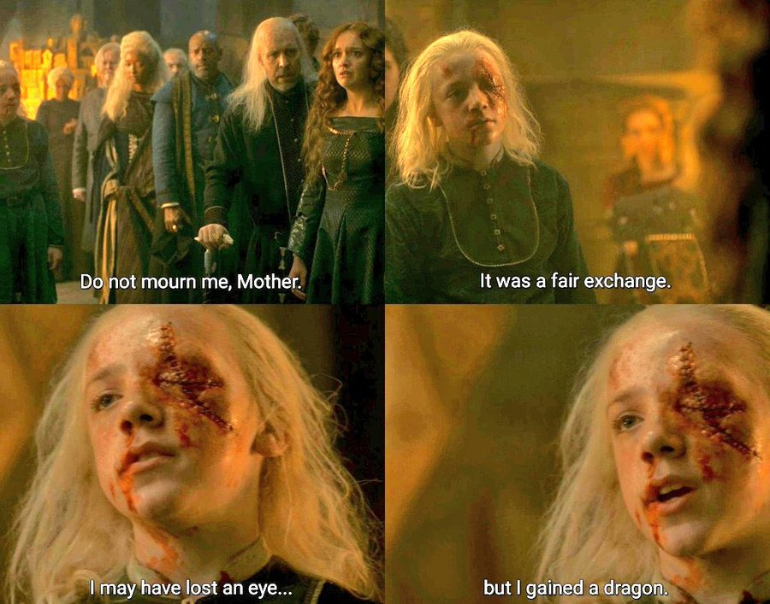
Special Purpose Protocols
Fair Exchange of Secrets

Slide 39
Special Purpose Protocols
R_{i} = R_{Li}+R_{Ri} = Bob’s Secret
M = Alice’s Secret
J = Junk Message
K = Key
K_{Li} = Random bits
K_{Ri} = K⊕K_{Li}
Fair Exchange of Secrets
E_{K}(M)
(R_{L1} , R_{R1})
(R_{L2} , R_{R2})
...
(R_{Ln} , R_{Rn})
(K_{L1} , K_{R1})
(K_{L2} , K_{R2})
...
(K_{Ln} , K_{Rn})
(C_{L1} , C_{R1})
(C_{L2} , C_{R2})
...
(C_{Ln} , C_{Rn})
(K_{L1} , K_{R1})
(K_{L2} , K_{R2})
...
(K_{Ln} , K_{Rn})
(J_{L1} , J_{R1})
(J_{L2} , J_{R2})
...
(J_{Ln} , J_{Rn})
(C_{L1} , C_{R1})
(C_{L2} , C_{R2})
...
(C_{Ln} , C_{Rn})
E_{KLi}(R_{Li})=C_{Li}
E_{KRi}(R_{Ri})=C_{Ri}
E_{KLi}(J_{Li})=C_{Li}
E_{KRi}(J_{Ri})=C_{Ri}
(C_{L1} , C_{R1})
(C_{L2} , C_{R2})
...
(C_{Ln} , C_{Rn})
K_{(L|R)1} K_{(L|R)2}
...
K_{(L|R)n}
(C_{L1} , C_{R1})
(C_{L2} , C_{R2})
...
(C_{Ln} , C_{Rn})
Oblivious
Transfer
1st bit of 2n keys
Now, decrypts the other half and obtains the signed contract
Now, decrypts the other half and obtains the signed contract
2nd bit of 2n keys
Bob obtains K by doing XOR
Alice obtains the acknowledgment receipt
.
.
.
Now, decrypts the other half and obtains the signed contract
Now, decrypts the other half and obtains the signed contract
n^{th} bit of 2n keys

Slide 40
Special Purpose Protocols
Mental Poker
Alice and Bob want to play poker, we need a way to deal 5 cards to each of Alice and Bob so that
Alice’s hand of 5 cards does not overlap with Bob’s hand
Neither Alice nor Bob can control which cards they each get
Neither Alice nor Bob knows the other party’s hand
Both hands should be random provided one party follows the protocol
First solution due to Shamir, Rivest, and Adelman in 1980
uses commutative encryption schemes

Slide 41
Special Purpose Protocols
Mental Poker
Alice encrypts M1, M2, …, M52 and then randomly permute them and send the ciphertexts to Bob
Bob picks 5 cards as Alice’s hand and sends them to Alice
Alice decrypts them to get his hand
Bob picks 5 other cards as his hand, encrypts them using his key, and sends them to Alice
Alice decrypts the 5 ciphertexts and sends to Bob
Bob decrypts what Alice sends and gets his hand
Both Alice and Bob reveals their key pairs to the other party and verify that the other party was not cheating.

Slide 42
Special Purpose Protocols
M
1
M
2
...
M
52
Mental Poker
E_{KA}(M_{i})
Commutative
D_{K1}(E_{k2}(E_{k1}(m))) = E_{k2}(m)
A
M
v
A
M
w
A
M
x
A
M
y
A
M
z
A
M
1
A
M
2
...
A
M
52
A
M
1
A
M
2
...
A
M
52
E_{KB}(E_{KA}(M_{i}))
A
M
v
A
M
w
A
M
x
A
M
y
A
M
z
Here are Alice’s hand.
She decrypts them.
A
M
a
A
M
b
A
M
c
A
M
d
A
M
e
B
B
B
B
B
A
M
v
A
M
w
A
M
x
A
M
y
A
M
z
B
B
B
B
B
M
v
M
w
M
x
M
y
M
z
Here are Bob’s hand.
He decrypts them.
B
B
B
B
B
K_{A} , K_{B}

Slide 43

Special Purpose Protocols
Dining Cryptographers
Cryptographers gather around a table for dinner.
The waiter informs them that the meal has been paid for by someone, who could be one of the cryptographers or NSA.
The cryptographers respect each other's right to make an anonymous payment, but want to find out whether the NSA paid.

Slide 44
Special Purpose Protocols
Dining Cryptographers
A
P_{A}: C_{AB}⊕C_{AC}
Suppose 3 cryptographers.
Every two cryptographers establish a shared one-bit secret, say by tossing a coin.
In the second stage, each cryptographer publicly announces a bit, which is:
if they didn't pay for the meal, the XOR of the two shared bits they hold with their two neighbours,
if they did pay for the meal, do an extra XOR with bit 1 (or negate his result)
Computes the XOR of the three bits announced. If the result is 0, it implies that the NSA must have paid the bill. Otherwise, one of the cryptographers paid.
C_{AB}
C_{AC}
C_{BC}
B
C
P_{B}: C_{AB}⊕C_{BC}
P_{C}: C_{AC}⊕C_{BC}
Result: P_{A}⊕P_{B}⊕P_{C}

Slide 45

Special Purpose Protocols
Dining Cryptographers
A
P_{A}: C_{AB}⊕C_{AC}
Scenario 1: NSA paid
C_{AB} = 0
C_{AC} = 1
P_{A}: C_{AB}⊕C_{AC} = 0⊕1 = 1
P_{B}: C_{AB}⊕C_{BC} = 0⊕1 = 1
P_{C}: C_{AC}⊕C_{BC} = 1⊕1 = 0
Result: P_{A}⊕P_{B}⊕P_{C} = 1⊕1⊕0 = 0
C_{BC} = 1
B
C
P_{B}: C_{AB}⊕C_{BC}
P_{C}: C_{AC}⊕C_{BC}
Result: P_{A}⊕P_{B}⊕P_{C}

Slide 46
Special Purpose Protocols
Dining Cryptographers
A
P_{A}: C_{AB}⊕C_{AC}
Scenario 2: One of the cryptographers paid (Suppose B)
C_{AB} = 0
C_{AC} = 1
P_{A}: C_{AB}⊕C_{AC} = 0⊕1 = 1
P_{B}: ~(C_{AB}⊕C_{BC}) = ~(0⊕1) = 0
P_{C}: C_{AC}⊕C_{BC} = 1⊕1 = 0
Result: P_{A}⊕P_{B}⊕P_{C} = 1⊕0⊕0 = 1
C_{BC} = 1
B
C
P_{B}: C_{AB}⊕C_{BC}
P_{C}: C_{AC}⊕C_{BC}
Result: P_{A}⊕P_{B}⊕P_{C}

Slide 47
Ref
Cryptography Protocols Course, Dr. Hamid Mala, University of Isfahan
https://www.cs.purdue.edu/homes/ninghui/courses/Fall05/lectures/355_Fall05_lect25.pdf
https://en.wikipedia.org/wiki/Dining_cryptographers_problem
https:// freepik.com
https://www.iconfinder.com/UsersInsights
https://www.iconfinder.com/Chanut-is
https://www.iconfinder.com/iconsets/softwaredemo

